Slide 1
Game Playing

Slide 2
Games like chess which use strategies are famous to improve the intelligence level in humans. The same motivation accounts for interest in the Computer Game Playing.
Programs that think better should be able to win more games and that’s where the Artificial Intelligence comes into the picture.

Slide 3
Game Playing
Why do AI researchers study game playing?
It’s a good reasoning problem, formal and nontrivial.
Direct comparison with humans and other computer programs is easy.

Slide 4
What Kinds of Games?
Mainly games of strategy with the following characteristics:
Sequence of moves to play
Rules that specify possible moves
Rules that specify a payment for each move
Objective is to maximize your payment

Slide 5
Thus, any game can be defined by:
Initial state of the game
Operations defining legal moves
Successor function
Terminal test defining end of the game
Goal state
Path function

Slide 6
Characteristics of the Game Playing
Uncertainty: There is always an unpredictable opponent i.e. the opponent always introduces uncertainty.
Time Limits: Games are played under strict time constraints and so should be played effectively.
Unpredictable opponent → solution is a strategy specifying a move for every possible opponent reply
Time limits → unlikely to find goal, must approximate plan of attack

Slide 7
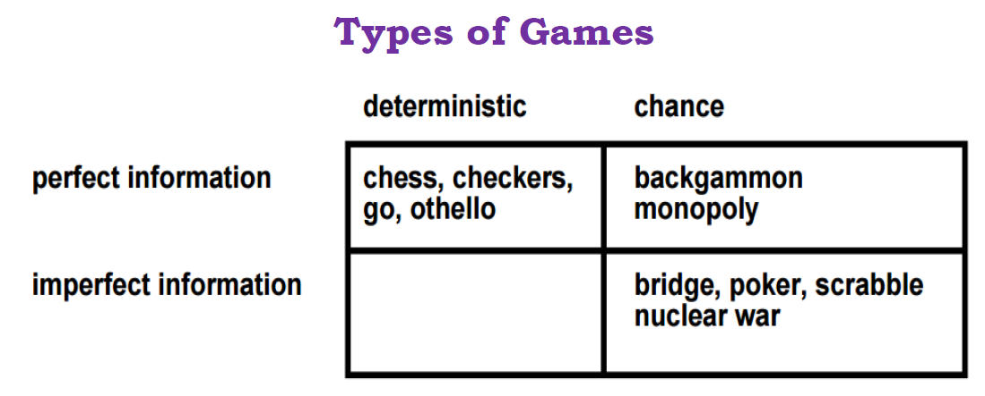

Slide 8
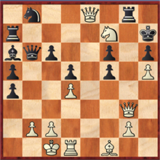
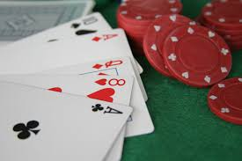
Types of Games
Perfect Information games are the games in which the players have the access to the same information about the game in the process. Each player knows or can see other player’s moves.
Imperfect Information games are the games in which the players do not have access to the same information about the game in the process. Players need to balance all possible outcomes when making a decision.

Slide 9
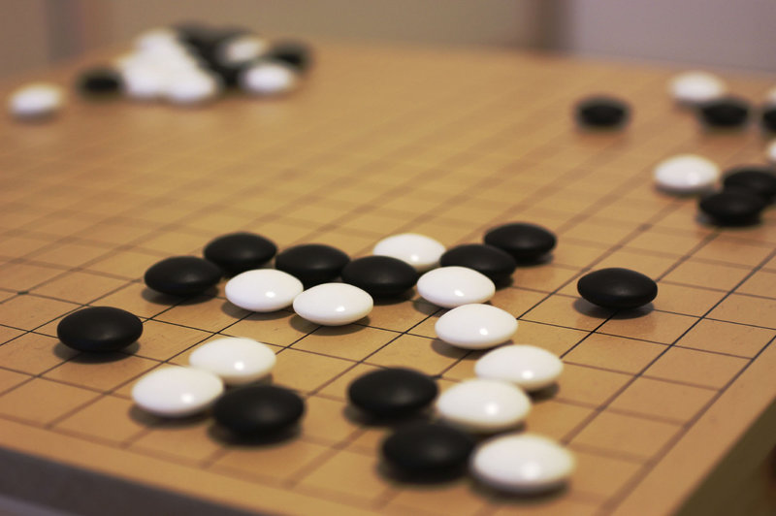
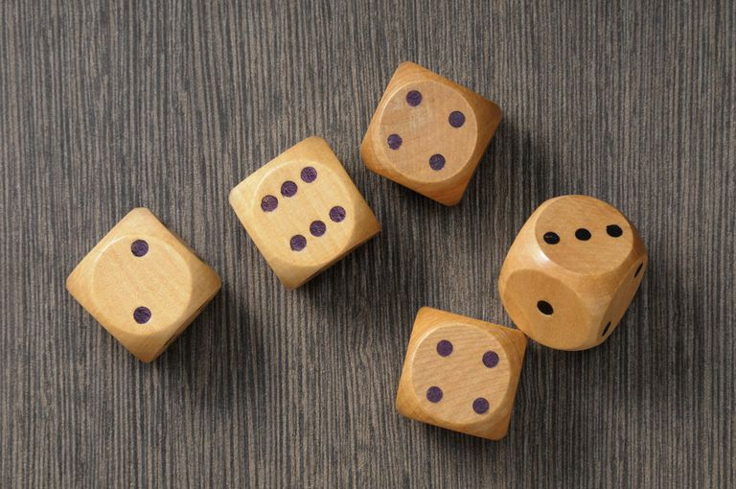
3. Deterministic games are the games in which the resolution of player actions leads to completely predictable outcomes. Deterministic just means that you give an input and always have the same output. In chess, if you move your piece, both you and your opponent know where it's going to end up. It doesn't randomly fail to move.
4. Chance games are the games in which the outcome is strongly influenced by some randomizing device, and upon which players may choose to wager money. Common devices used include dice, spinning tops, playing cards, roulette wheels, or numbered balls drawn from a container. Chance generally plays a greater role in determining the outcome than skill.

Slide 10
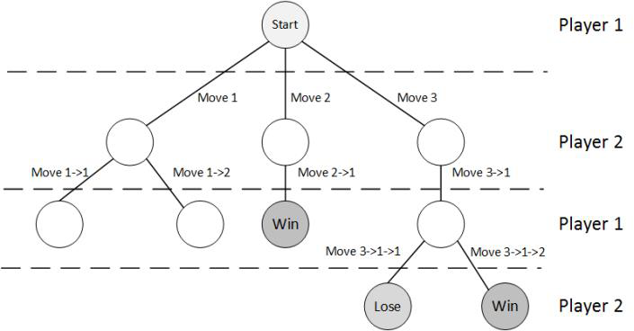
Game trees

Slide 11
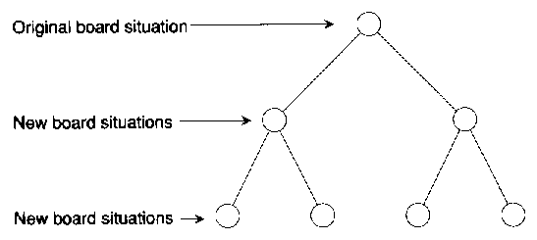
Game Trees
You learn about how programs can play games, such as checkers and chess.
p = d = 2
The ply of a game tree, p = d, where d is the depth of a tree.

Slide 12
Features of a game tree
A deterministic, turn based, finite game with perfect information
The root is the initial position
The children of the root are possible positions after one move
The grandchildren of the root are possible positions after two moves, and so on.

Slide 13
The leaves represent possible endings
They contain information about the value (utility) of the ending to each of the players, which is calculated for the player which has the current move of that step.
Intermediate nodes also contain such information, but mostly they are not considered since the leaves have the effect of them
In a zero-sum game, what one player gains, the other player loses

Slide 14
Game Playing Strategy
Maximize winning possibility assuming that opponent will try to minimize (Minimax Algorithm)
Ignore the unwanted portion of the search tree (Alpha Beta Pruning)
Evaluation(Utility) Function
A measure of winning possibility of the player

Slide 15
Mini-max
Perfect play for deterministic, perfect-information games
Idea: choose move to position with highest minimax value
= best achievable payoff against best play
Evaluations

Slide 16
Mini-Max Terminology
utility function: Utility in game theory is a measure of rational choice when playing a game. In general, it can be viewed as a function that is able to assist a search algorithm to decide which path to take.The function applied to leaf nodes
backed-up value
of a max-position: the value of its largest successor
of a min-position: the value of its smallest successor
Mini-max procedure: search down several levels; at the bottom level apply the utility function, back-up values all the way up to the root node, and that node selects the move.

Slide 17
Minimax Strategy
Why do we take the min value every other level of the tree?
These nodes represent the opponent’s choice of move.
The computer assumes that the human will choose that move that is of least value to the computer.

Slide 18
Minimax Algorithm
Generate the game tree
Apply the utility function to each terminal state to get its value
Use these values to determine the utility of the nodes one level higher up in the search tree
From bottom to top
For a max level, select the maximum value of its successors
For a min level, select the minimum value of its successors
From root node select the move which leads to highest value

Slide 19
So, in mini-max algorithm
At each node,
If the node is a max node, the child with the maximum utility is selected.
If the node is a min node, the child with the minimum utility is selected.
At the root, the child that gives the best utility which is the,
The maximum utility if the root is a max node.
The minimum utility if the root is a min node.
is selected.

Slide 20
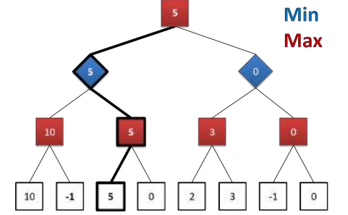
An abstract game tree illustrating the Minimax algorithm.
In this hypothetical game of two options for each player max (represented as red squares) plays first, min (represented as blue diamonds) plays second and then max plays one last time. White squares denote terminal nodes containing a winning (positive), a losing (negative) or a draw (zero) score for the max player.
Following the Minimax strategy, the scores (utility) are traversed up to the root of the game tree. The optimal play for max and min is illustrated in bold. In this simple example if both players play optimally, max wins a score of 5.

Slide 21
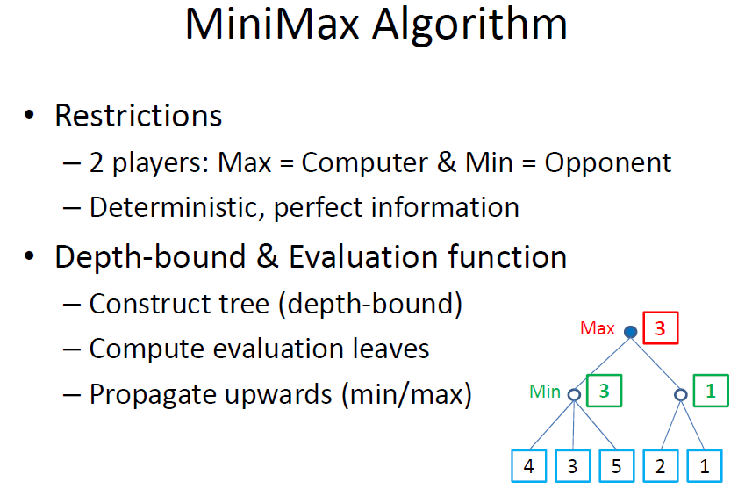
To summarize

Slide 22
Properties of Minimax
Complete: Yes (if tree is finite)
Optimal: Yes (against an optimal opponent)
Time complexity: O(b^{m})
Space complexity : O(bm) (depth-first exploration)

Slide 23
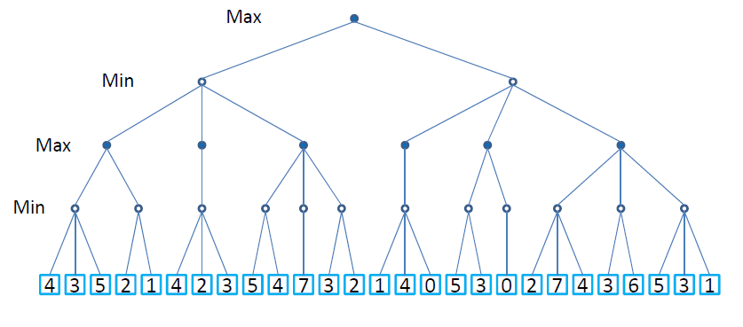
Another example

Slide 24
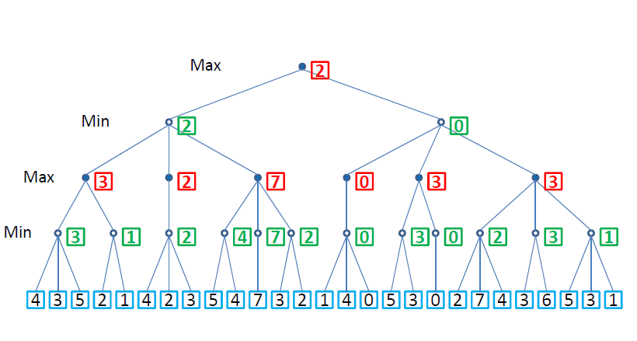

Slide 25
Alpha-beta pruning
The alpha-beta procedure can speed up a depth-first mini-max search.
Pruning = cutting off parts of the search tree (because you realize you don’t need to look at them)
When we considered A* we also pruned large parts of the search tree

Slide 26
Alpha-Beta Strategy
Maintain two bounds:
Alpha (α): a lower bound on best that the player to move can achieve. Or value of best move for us seen so far in current search path
Beta (β): an upper bound on what the opponent can achieve. Or best move for opponent (worst move for us) seen so far in current search path.
Search, maintaining α and β
Whenever α ≥ βhigher, or β ≤ αhigher further search at this node is irrelevant.(If alpha>=beta, prune)

Slide 27
How to Prune the Unnecessary Path
If beta value of any MIN node below a MAX node is less than or equal to its alpha value, then prune the path below the MIN node.
If alpha value of any MAX node below a MIN node exceeds the beta value of the MIN node, then prune the nodes below the MAX node.

Slide 28
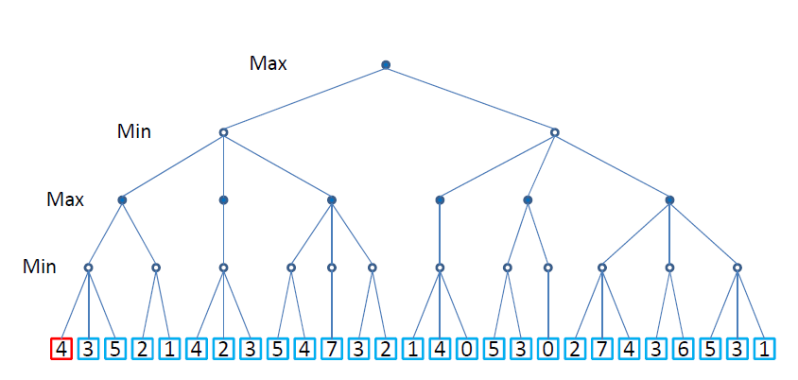
example

Slide 29
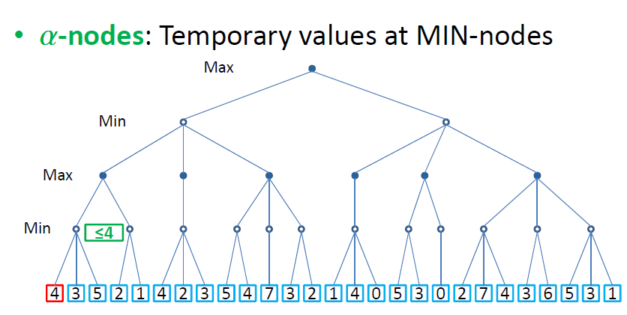

Slide 30
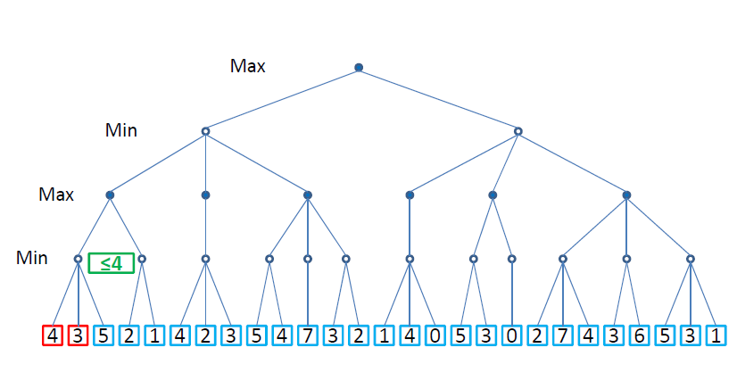

Slide 31
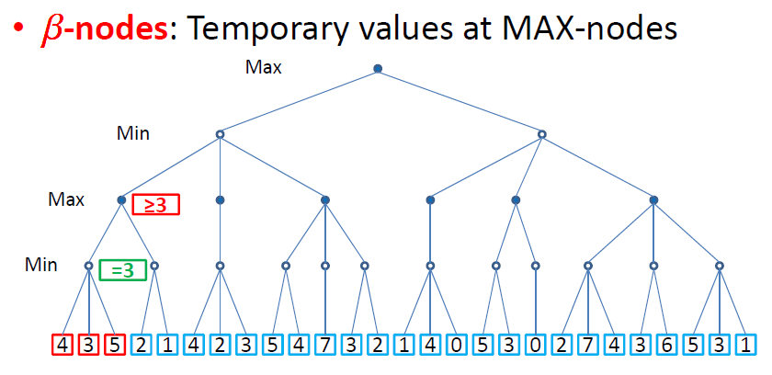

Slide 32
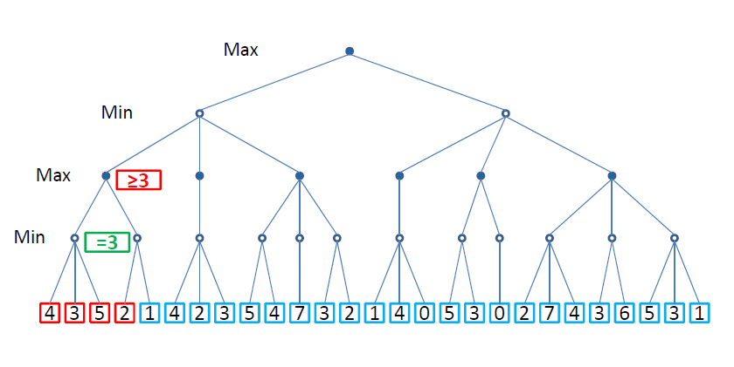

Slide 33
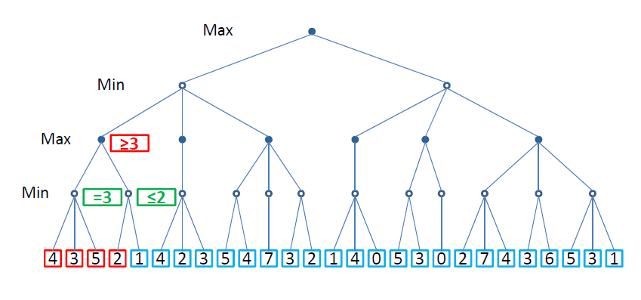

Slide 34
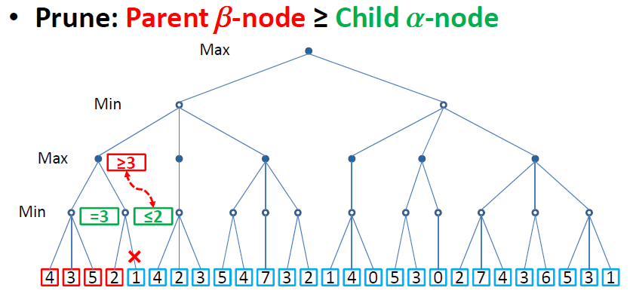

Slide 35
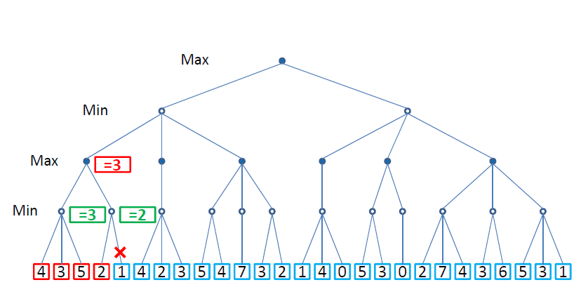

Slide 36
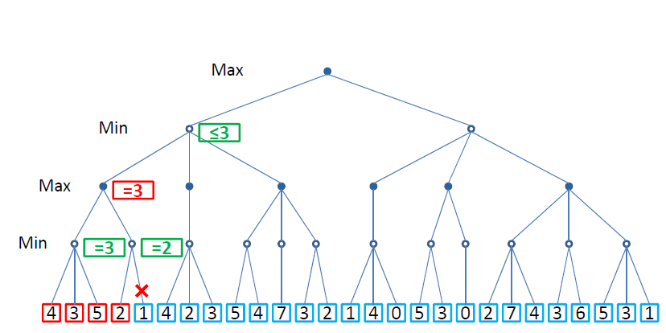

Slide 37
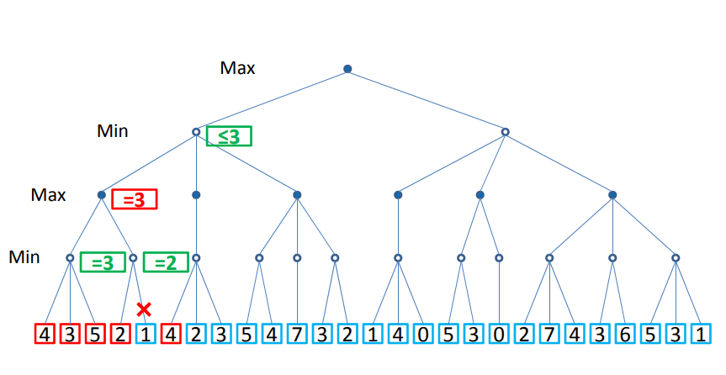

Slide 38
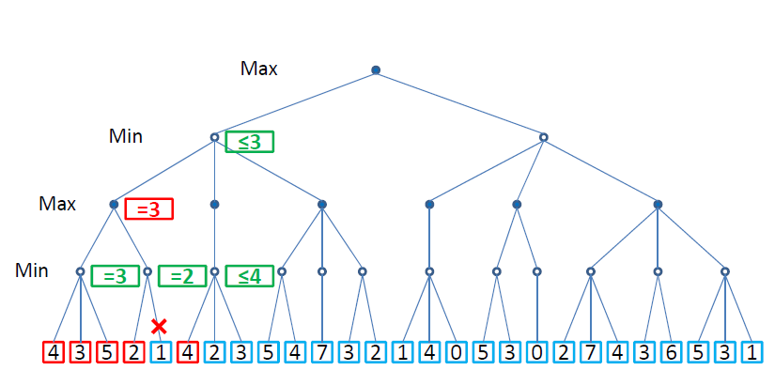

Slide 39
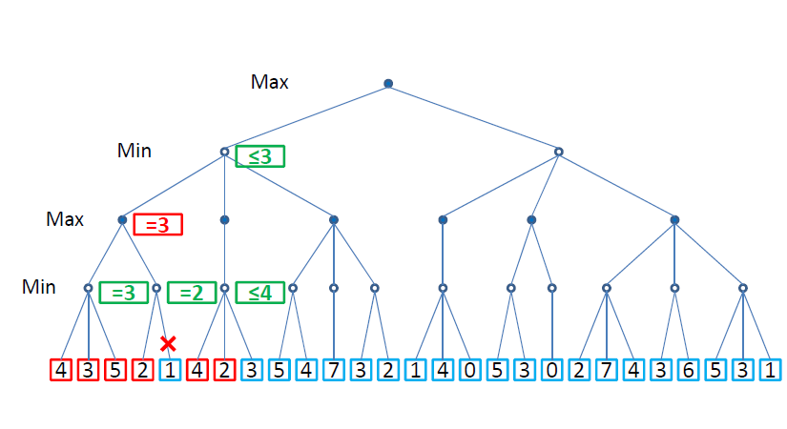

Slide 40
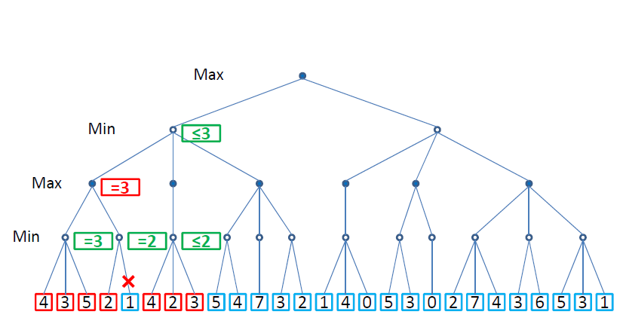

Slide 41
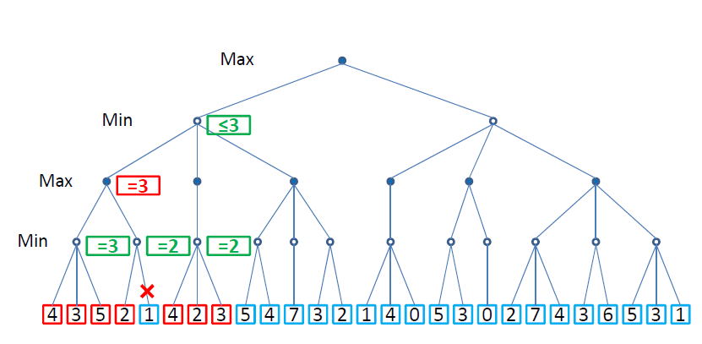

Slide 42
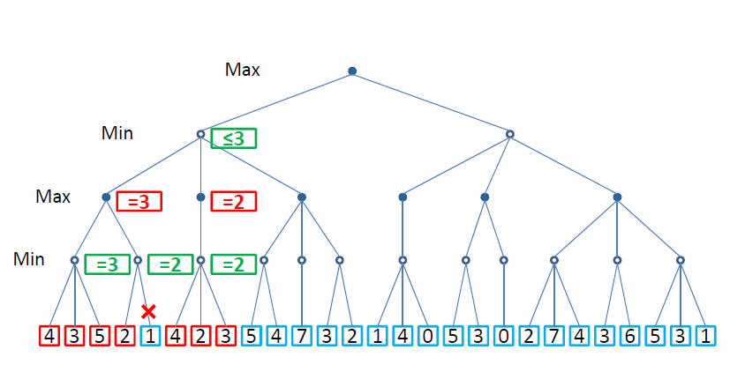

Slide 43
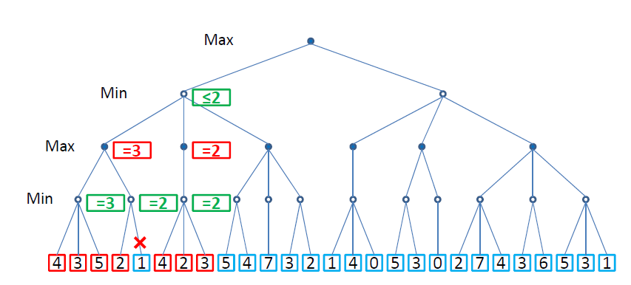

Slide 44
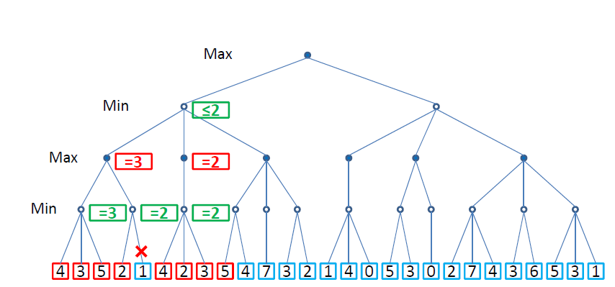

Slide 45
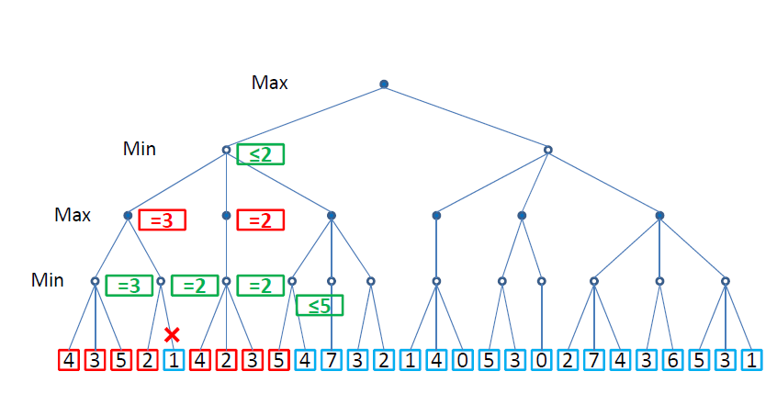

Slide 46
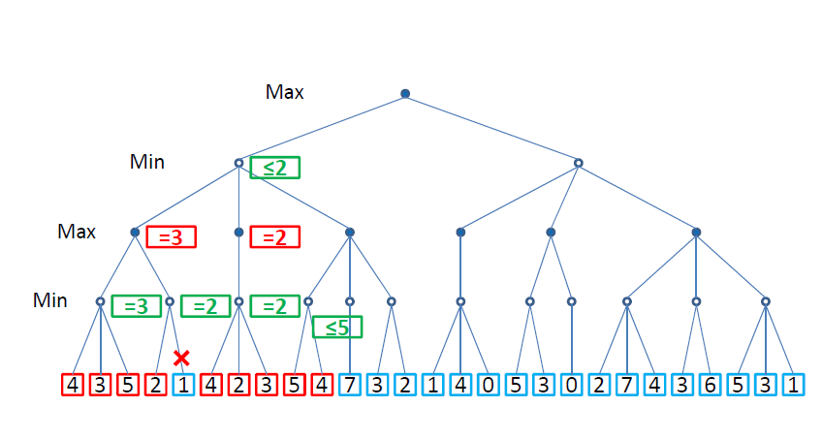

Slide 47
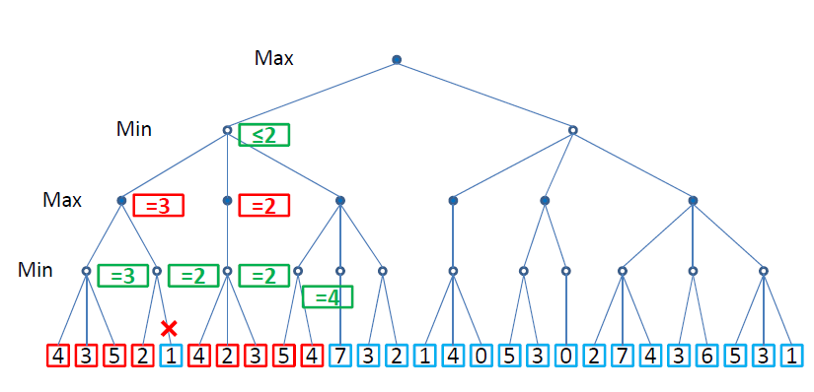

Slide 48
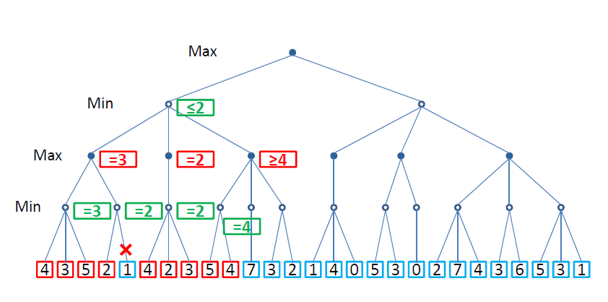

Slide 49
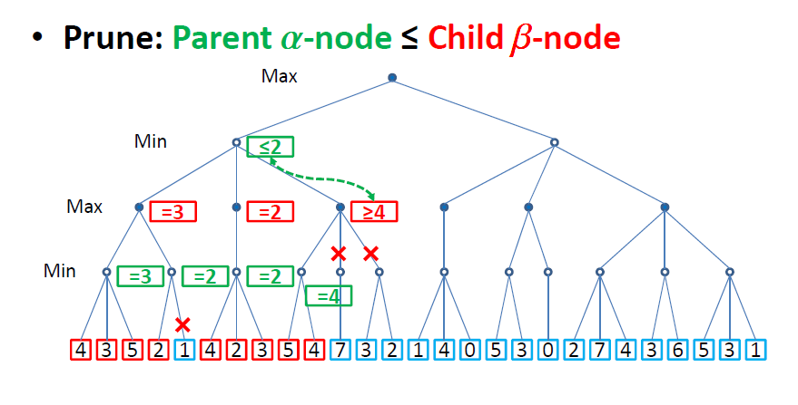

Slide 50
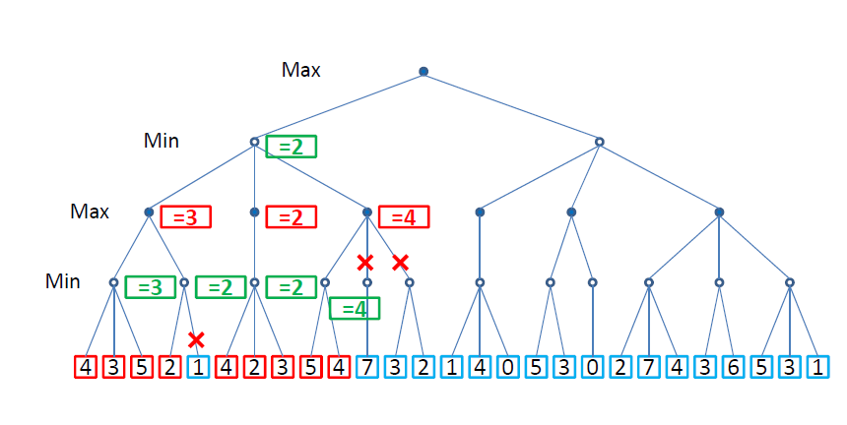

Slide 51
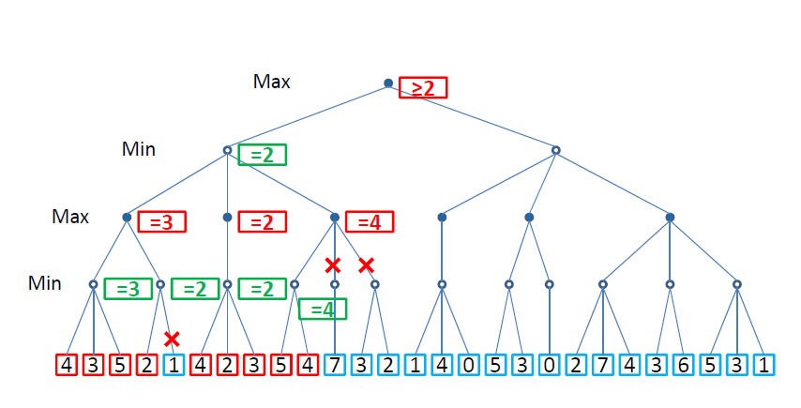

Slide 52
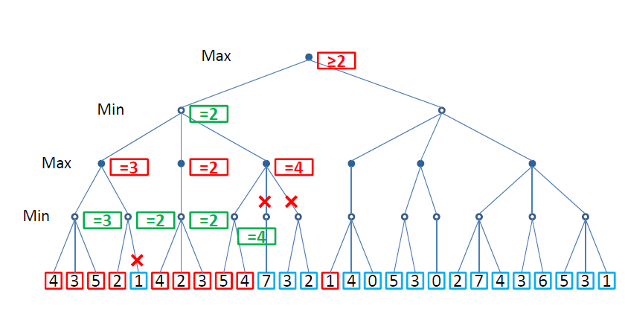

Slide 53
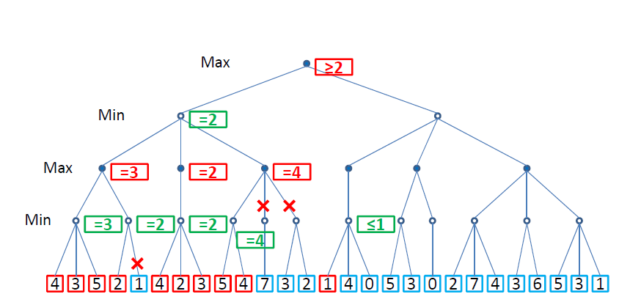

Slide 54
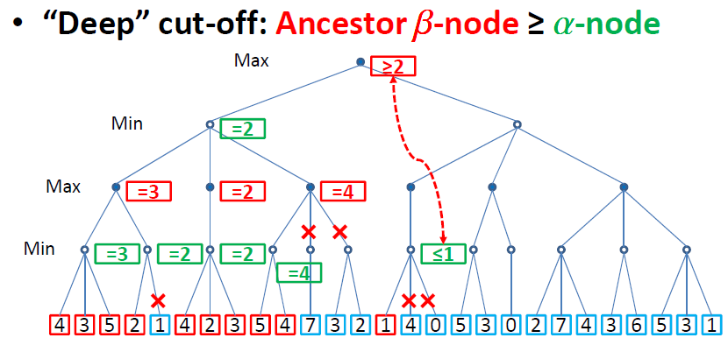

Slide 55
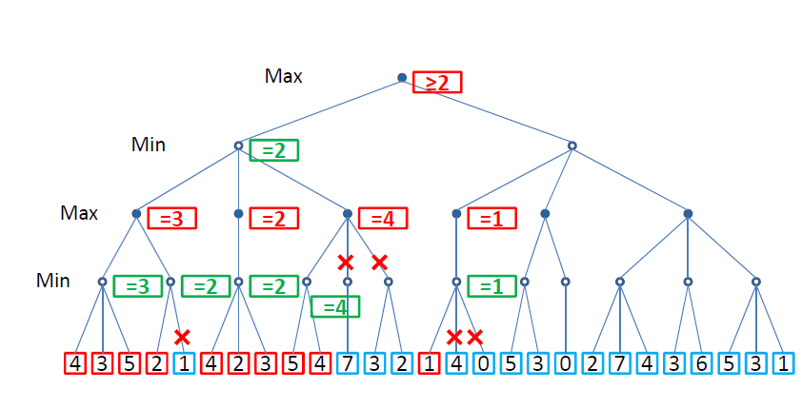

Slide 56
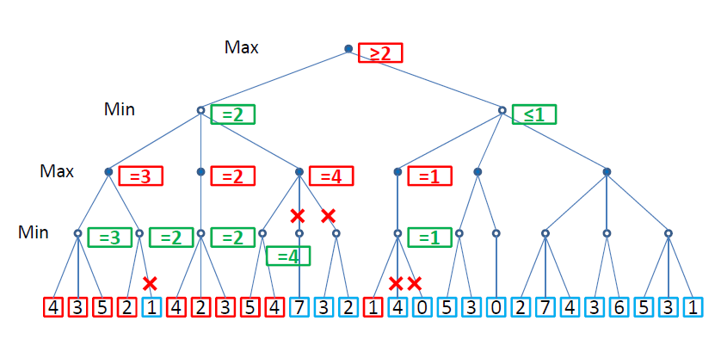

Slide 57
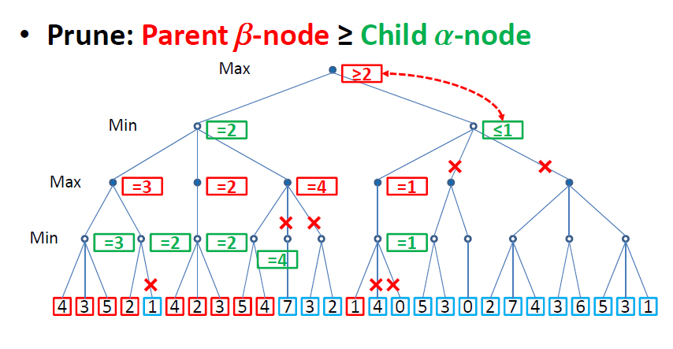

Slide 58
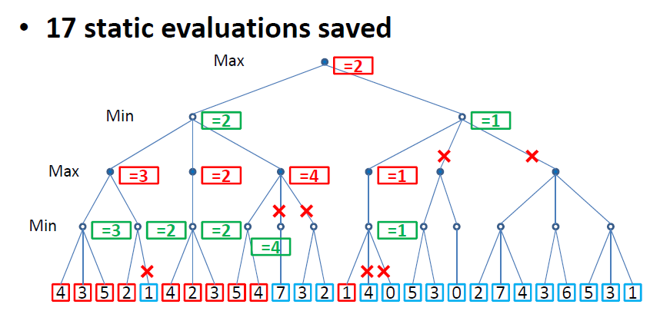

Slide 59
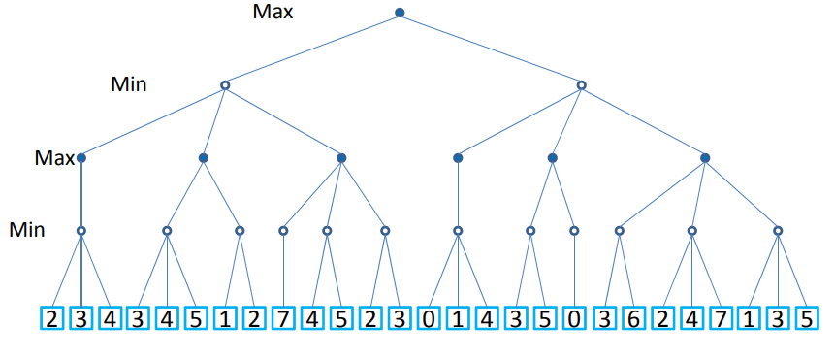
Problem 2

Slide 60
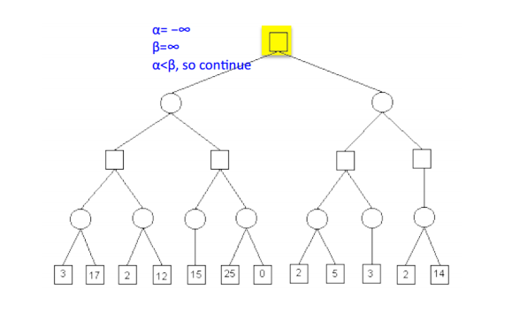
Problem 3: Solved example

